Slide 1
Transaction Management
Chapter 14
Notes:
Hello, Today presenter is Yeeun shim and Changbum Shim.
chapter fourteen is transaction management.

Slide 2
Objects
The functionality and the technique
The recovery manager
The concurrency manager
Notes:
In this chapter, we study the recovery and concurrency managers,
Their jobs are to maintain order and ensure database integrity.
This chapter treats the functionality and the technique of these managers.

Slide 3
Contents
Transactions
Using Transactions in SimpleDB
Recovery Management
Concurrency Management
Implementing SimpleDB Transactions
Notes:
Contents is the following.

Slide 4
Contents
Transactions
Correct Code that Behave Incorrectly
Properties of Transactions
Using Transactions in SimpleDB
Recovery Management
Concurrency Management
Implementing SimpleDB Transactions
Notes:
First, I explain the transaction.

Slide 5
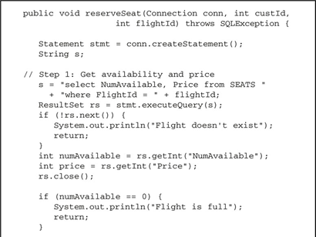
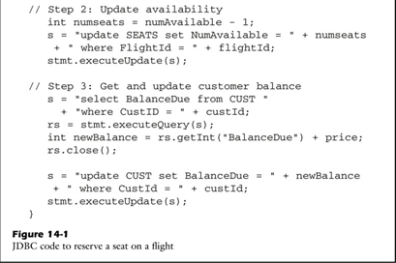
Correct Code that Behaves Incorrectly
Consider an airline reservation database, having two tables with the following schemas:
SEAT (FlightId, NumAvailable, Price)
CUST (CustID, BalanceDue)
Although following code has no bugs, various problems can occur.
Step 1 :
Get availability and price
Step 3 :
Get and update customer balance
Step 2 :
Update availability
Notes:
Consider an airline reservation database. We have two tables with the following schemas.
As you see, This code has no bugs, but various problems can occur.
This code has 3 step.
First step get availability and price.
Next, second step update availability.
Finally, third step get and update customer balance.

Slide 6
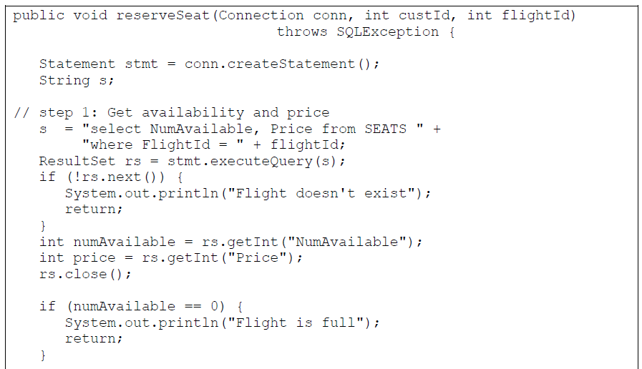
Correct Code that Behaves Incorrectly (cont’)
The first scenario
Suppose that both clients A and B run this code concurrently, and some actions occur:
Client A executes all of Step 1, and is then interrupted.
Client B executes to completion.
Client A completes its execution.
Two seats will be sold, but the number of available seats will be decremented only once.
Client A & B get the same value
of numAvailable.
Notes:
The following three scenarios show various problems.
For the first scenario, suppose that both clients A and B run this cod concurrently.
This situation can occur the following actions.
Client A executes all of step 1 that get availability and price, and is then interrupted.
Next, client B executes to completion. So, if the value of numavailable of client A was 10, the value of numAvailable is decreased to 9.
Finally, Client A completes it execution. Consequently, two sets will be sold, but the numAvailable will be decremented only once.
Client A and B get the same value of numAvailable.

Slide 7
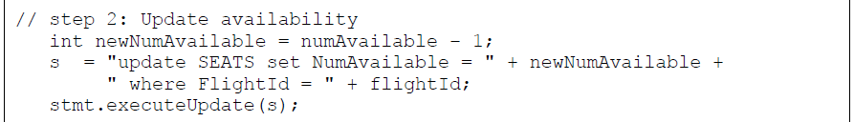
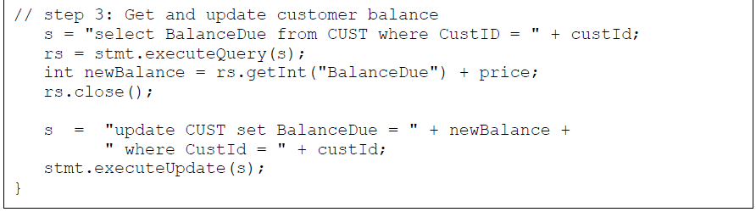
Correct Code that Behaves Incorrectly (cont’)
The second scenario
Suppose that thread C is running the code, and the server crashes just after Step 2 executes.
The seat will be reserved, but the customer will not be charged for it.
The third scenario
Suppose that a client runs the code to completion, but the modified pages are not immediately written to disk due to buffering.
If the server crashes sometime later, then there is no way to know which of the pages were eventually written to disk.
Notes:
The second scenario, suppose that thread C is running the code, and the server crashes just after step 2 that update availability executes.
Finally, the seat will be reserved, but the customer will not be charged for it. Because step 3 get and update customer balance, thread C is not charged.
The third scenario is that a client runs the code to completion, but the modified pages are not immediately written to disk due to buffering.
If the first update was written but not the second, the customer is charged for a nonexistent ticket.

Slide 8
Properties of Transactions
A transaction is a group of operations that behaves as a single operation.
A transactions should satisfy the four ACID properties.
Atomicity: A transaction is “all or nothing.”
Consistency: Every transaction leaves the database in a consistent state.
Isolation: A transaction behaves as if it is the only thing running on the system.
Durability: Changes made by a committed transaction are guaranteed to be permanent.
The atomicity and durability properties:
The proper behavior of the commit and rollback operations.
The consistency and isolation properties:
The proper behavior of concurrent clients.
Notes:
And then, What is the transaction?
A transaction is a group of operations that behaves as a single operation.
For example, single query is transaction.
A transaction should satisfy the four properties.
Atomicity(아토미씨티) means that a transaction is “all or nothing”. That is, either all of operations succeed, or they all fail. The second scenario not satisfies atomicity.
Consistency means that every transaction leaves the database in a consistent state.
For example, assume that client A send 100 dollars to client B.
After sending money, if the sum of balance of client A and client B is not the same to before the total balance, this situation not satisfies consistency.
Isolation means that a transaction behaves as if it is the only thing running on the system. That is, the result should be the same as if they were all executed serially in some order. The first scenario not satisfies isolation.
Durability means that changes made by a committed transaction are guaranteed to be permanent. The third scenario not satisfies durability.
In simple, the atomicity and durability properties are related to commit and rollback operations.
And, the consistency and isolation properties are related to concurrent clients.

Slide 9
Contents
Transactions
Using Transactions in SimpleDB
Recovery Management
Concurrency Management
Implementing SimpleDB Transactions
Notes:
Next, I explain that using transactions in simpleDB

Slide 10
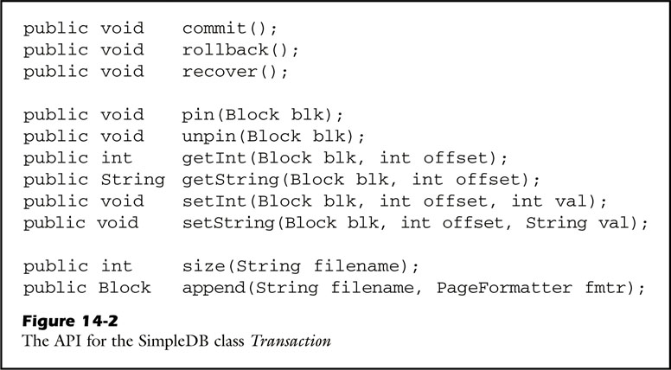
Using Transactions in SimpleDB
The methods of Transaction fall into three categories.
The transaction’s lifespan
The methods to access a disk block
Two methods related to the file manager.
The first category consists of methods related to the transaction’s lifespan.
Notes:
The method of transaction in simpleDB fall into three categories.
The transaction’s lifespan and the methods to access a disk block, and two methods related to the file manager.
The first category that is transaction’s lifespan consists of the following.
Commit means the end of transaction. Rollback means that a transaction return to previous statement.
Recover means that uncommitted transactions perform a rollback.

Slide 11
Using Transactions in SimpleDB (cont’)
The second category consists of methods to access a disk block.
The third category consists of two methods related to the file manager.
Notes:
The second category consists of methods to access a disk block.
Pin and unpin explained last class. GetInt and getString passes the result back to the client.
SetInt and Setstring writes the values that client want.
The third category consists of two method related to the file manager.
Size and append method is explained last class alike pin and unpin.

Slide 12
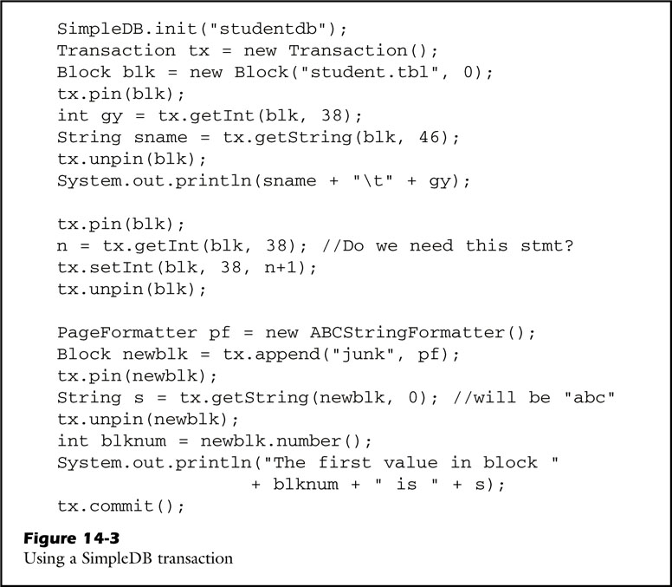
Using Transactions in SimpleDB (cont’)
A simple use of the Transaction methods.
Notes:
This code is that a simple use of the transaction methods.
For example, observe that both the first and second sections of the code have the same call to getint.
Why this code call that second call? As you see, This statement means that if transaction can concurrency control, variable gy and n are the same.
But if it cannot, two variables can not equal.

Slide 13
Contents
Transactions
Using Transactions in SimpleDB
Recovery Management
Log Records, Rollback, Recovery, Undo-Only and Redo-Only Recovery
Write-Ahead Logging, Quiescent Checkpointing, Nonquiescent Checkpointing,
Data Item Granulatiy, The SimpleDB Recovery Manager
Concurrency Management
Implementing SimpleDB Transactions
Notes:
This contents, I explain recovery management.

Slide 14
Recovery management
The recovery manager has three functions
To write log records
To roll back a transaction
To recover the database after a system crash
Notes:
The recovery manager is the portion of the server that reads and processes the log.
The recovery manager has three functions.
To write log records, to roll back a transaction, and to recover the database after a system crash.

Slide 15
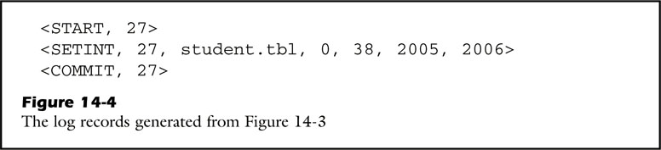
Log Records
Three activities can cause log records to be written:
A start record is written when a transaction begins.
A commit record or rollback record is written when a transaction completes.
An update record is written when a transaction modifies a value.
Notes:
Log records has three activities.
A start record is written when a transaction begins.
A commit record or rollback record is written when a transaction completes.
An update record is written a transaction modifies a value.
This figure is example of log records.
This is start record, and commit record.
This is update record, and this contains transaction id, file name, block number, offset, old value, new value.

Slide 16
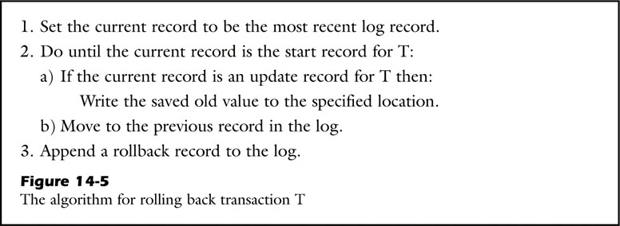
Rollback
The recovery manager rolls back a transaction by undoing its modifications.
Notes:
The recovery manager rolls back a transaction by undoing its modifications.
This figure illustrates the algorithm for rolling back transaction T.
Rollback is restore the original contents of each modified value.
So, set the current record to be the most recent log record, and do until the current record is the start record for T,
Rewrite the old vale of the modified value.

Slide 17
Recovery
Recovery is performed each time the database system starts up.
It’s purpose is to restore the database to a reasonable state.
Reasonable state
All uncompleted transactions should be rolled back.
All committed transactions should have their modifications written to disk.
The modifications made by
uncompleted transactions: undone
committed transactions: redone
Notes:
Recovery is performed each time the database system starts up.
It’s purpose is to restore the database to a reasonable state.
Reasonable state means that all uncompleted transactions should be rolled back.
And all committed transactions should have their modifications written to disk.
During recovery, modifications made by uncompleted transactions are undone, and committed transactions are redone.

Slide 18
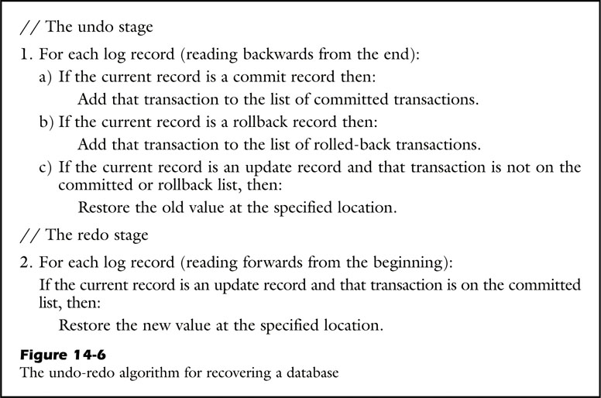
Recovery (cont’)
The recovery manager must flush the commit log record to disk before it completes a commit operation.
Notes:
The recovery manager must flush the commit log record to disk before it completes a commit operation.
This figure is the undo-redo algorithm for recovering a database.
Undo-redo algorithm fall into undo stage and redo stage.
Undo stage reads the log backwards. So, this stage must read the entire log.
Redo stage redoes the committed transactions. The log must be read forward during the redo stage.
The difference of two stage is that undo stage rolls back the original value of uncommitted transaction but redo stage restore modified value of committed transaction.

Slide 19
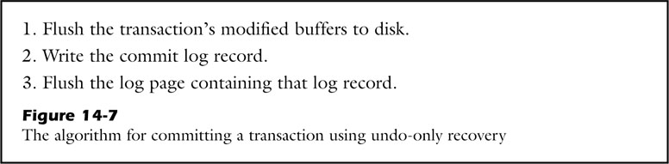
Undo-Only Recovery
The redo stage can be omitted.
If the recovery manager is sure that all committed modifications have been written to disk.
Undo-only recovery is faster.
It requires only one pass through the log file, instead of two.
The commit operation is much slower.
It must flush the modified buffers.
Notes:
Recovery manager uses undo-only recovery.
If the recovery manager sure that all committed modifications have been written to disk.
Undo-only recovery is faster than undo-redo recovery, because it requires only on pass through the log file.
But, because the commit operation is much slower, if system crashes are infrequent, undo-redo recovery is faster than undo-only recovery.
The reason can show through this algorithm.
Undo-only recovery algorithm write the modified transaction to disk before commit log write unlike undo-redo recovery algorithm.

Slide 20
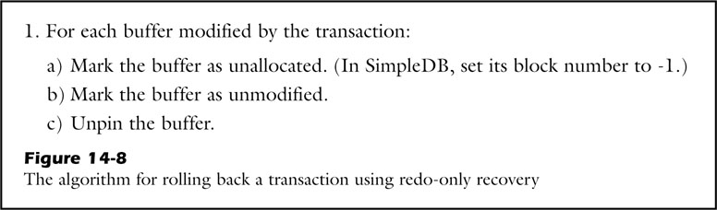
Redo-Only Recovery
The undo stage can be omitted.
If the recovery manager is sure that all uncommitted buffers have not been written to disk.
Redo-only recovery is faster than undo-redo recovery.
The uncommitted transactions can be ignored.
However, It requires that each transaction keep a buffer pinned for every block that it modifies.
Notes:
**공부하기
the recovery manager can use redo-only recovery.
if recovery manager is sure that all uncommitted buffers have not been written to disk, the undo stage can be omitted.
Alike undo-only recovery, this is faster than undo-redo recovery.
But, it requires that each transaction keep a buffer pinned for every block that it modifies.
As you see, this figure shows the reason. Redo-only ignore the uncommitted transaction, so it modifies each buffer.
Redo-only recovery rolls back transaction by marking the buffer as unallocated and unmodified. And next unpin the buffer.

Slide 21
Write-Ahead Logging (WAL)
Assumption to justify the correctness of the undo stage:
All update records for an uncompleted transaction will be in the log file.
If the server crashes, there are four possibilities:
Both the page and the log record got written to disk.
Only the page got written to disk.
Only the log record got written to disk.
Neither got written to disk.
A modified buffer can be written to disk only after all of its update log records have been written to disk.
Notes:
Write-ahead logging named WAL has the following assumption to justify the correctness of the undo stage.
If the server crashes, there are four possibilities.
First both the page and log record got written to disk.
Only the page got written to disk.
Only the log record and neither got written to disk.
Unlike other situations, if only the page got written to disk, the recovery algorithm won’t find the log record, and so it will not undo the change to the data block.
WAL can be avoided if the recovery manager ensures that an update log record always gets written to disk before the corresponding modified buffer page.

Slide 22
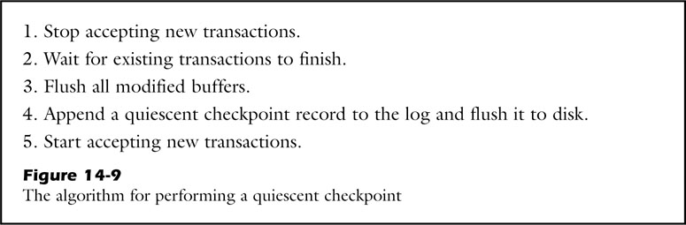
Quiescent Checkpointing
The recovery strategies have been devised for reading only a portion of the log.
The recovery algorithm can stop searching the log as soon as it knows:
All earlier log records were written by completed transactions. (undo)
The buffers for those transactions have been flushed to disk. (redo)
Notes:
The log contains the history of every modification to the database.
The recovery strategies have been devised for reading only a portion of the log.
So, the recovery algorithm can stop searching the log as soon as it know.
First, all earlier log record were written by completed transactions. This point applies to the undo stage.
Second, the buffers for those transactions have been flushed to disk. This point applies to the redo stage.

Slide 23
Quiescent Checkpointing (cont’)
The recovery algorithm never needs to look at the log records prior to a quiescent checkpoint record.
A good time to write a quiescent checkpoint record:
After a recovery has completed.
Before new transactions have begun.
Notes:
A feature of the recovery algorithm is that never needs to look at the log records prior to a quiescent checkpoint record.
Quiescent checkpoint is recorded in two case. After a recovery has completed or new transactions have begun.
This is the algorithm of quiescent checkpoint.
As you see, it is started after finish existing transactions, and start accepting new transactions after checkpoint record is flushed to disk.

Slide 24
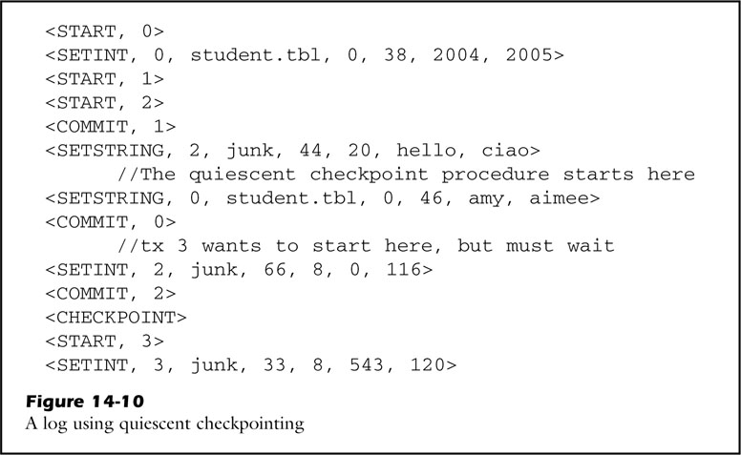
Quiescent Checkpointing (cont’)
The following log illustrates three things:
No new transactions can start once the checkpoint process begins
The checkpoint record was written as soon as the last transaction completed and the buffers were flushed.
Other transactions may start as soon as the checkpoint record is written.
Notes:
This source code is example using quiescent checkpoint.
No new transactions can start once the checkpoint process begins.
Next, as you see the checkpoint record was written after the last transaction completed.
Finally, after checkpoint record is written, new transactions start.

Slide 25
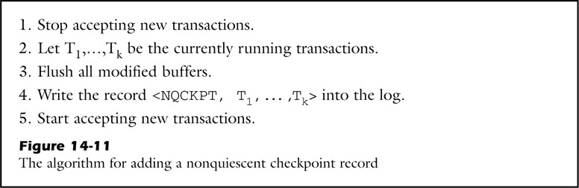
Nonquiescent Checkpointing
The database system is unavailable while the recovery manager waits for existing transactions to complete. (quiescent checkpointing)
The recovery algorithm never needs to look at the log records prior to the start record of the earliest transaction listed in a nonquiescent checkpoint record.
Notes:
However, quiescent checkpoint makes that recovery manager wait for existing transactions to complete.
On the other hands, nonquiescent checkpoint does not have to wait for existing transactions to complete.
As you see this figure, it writes currently running transactions list in the log
The recovery algorithm never needs to look at the log records prior to the start record of the earliest transaction listed in a nonquiescent checkpoint record.

Slide 26
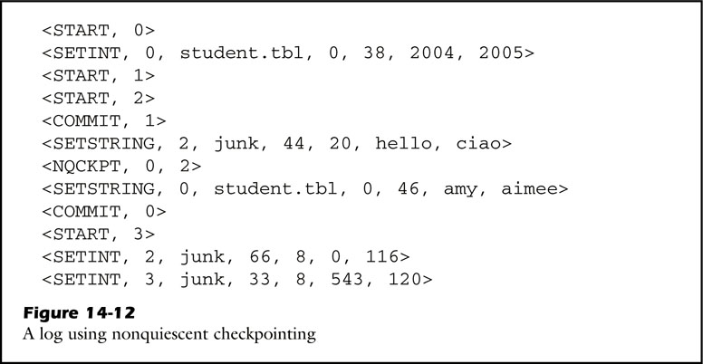
Nonquiescent Checkpointing (cont’)
Using nonquiescent checkpointing, consider the log of Fig. 14-10.
Notes:
This figure is example of nonquiescent checkpoint.
As you see, this record is written existing running transaction 0 and 2.
So, if start record of transaction 1 is found, it never needs to look at the log records.

Slide 27
Data Item Granularity
A recovery data item is the unit of logging used by the recovery manager. The size of a data item is called its granularity.
Instead of using values as data items, the recovery manager could choose to use blocks or files.
Logging blocks
Advantage: Fewer log records are needed if we user undo-only recovery.
Disadvantage: The update log records are now very large
Logging files
Advantage: A crude version of file-based logging is often used by non-databased applications.
Disadvantage: Each transaction would have to make a copy of the entire file, no matter how many value changed.
Notes:
A recovery data item is the unit of logging used by the recovery manager.
Granularity is the size of a data item.
In simpleDB, it uses values as data items. But the recovery manager could choose to use blocks or files.
Using blocks, its advantage is that create fewer log records but, the update log records are very large.
Using files, its advantage is that often used by non-databased applications.
For example, assume that we use word processor.
When your computer crashes while you are editing a file, word processor may be able to show the recently saved version and existed version at the time of the crash.

Slide 28
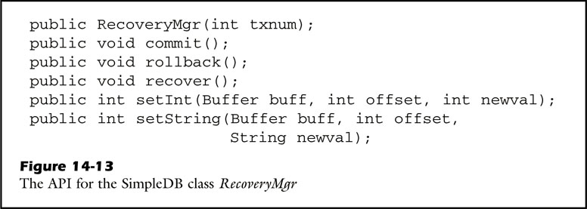
The SimpleDB Recovery Manager
Each transaction creates its own recovery manager.
The SimpleDB recovery manager chooses to use undo-only recovery with value-granularity data items.
Code to implement log records;
Code to iterate through the log file;
Code to implement the rollback and recovery algorithms.
Notes:
In the simpleDB, Each transaction creates its own recovery manager.
The figure is the API for the Recovery Manager class.
The simpleDB chooses to use undo-only recovery with value granularity data items.
The simpleDB recovery manager has the following code.

Slide 29
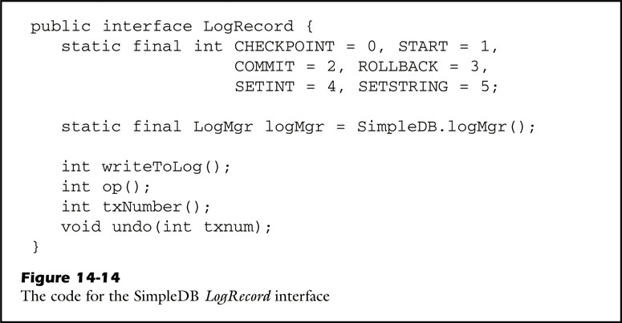
Log Records
SimpleDB implements a log record as an array of values.
Notes:
First, Log Records interface.
This integers indicate operation.
It has writeToLog, Operation, transaction number, undo method.

Slide 30
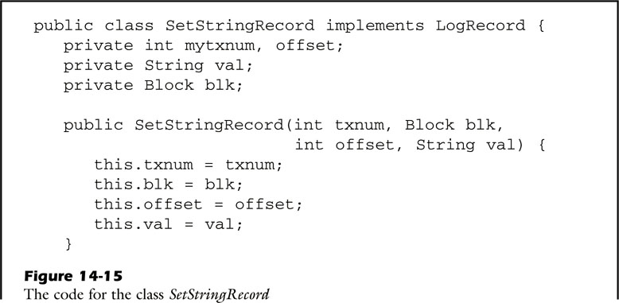
Log Records (cont’)
The classes for the individual kinds of log record all have similar code;
It should suffice to examine the code for one of the classes, say SetStringRecord.
Notes:
This source code is setstringrecord for update log.
The classes for the individual kinds of log record all have similar code.
The class has two constructors.

Slide 31
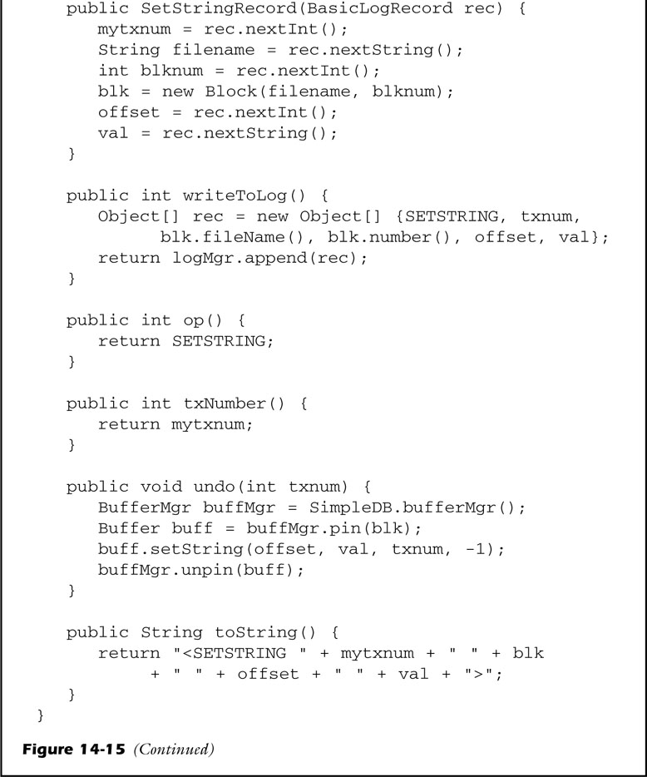
Log Records (cont’)
Notes:
In this class, The methods are implemented by log records interface.
Writetolog method appends the record to the log.
Op method returns operator of the record.
txNumber returns the ID of the transaction.
Undo method restores any changes stored in that record.

Slide 32
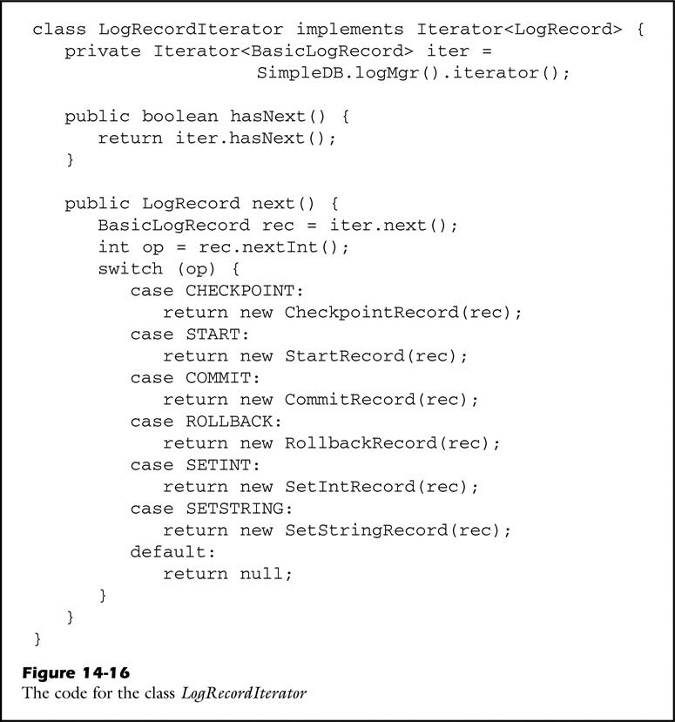
Iterating through the Log
The class LogRecordIterator allows a client to iterate backwards through the log file, and record at a time.
Notes:
The class logrecorditerator has two method, hasnext and next.
Next obtains the next basic log record from the iterator.
Hasnext return that whether log file has log record.

Slide 33
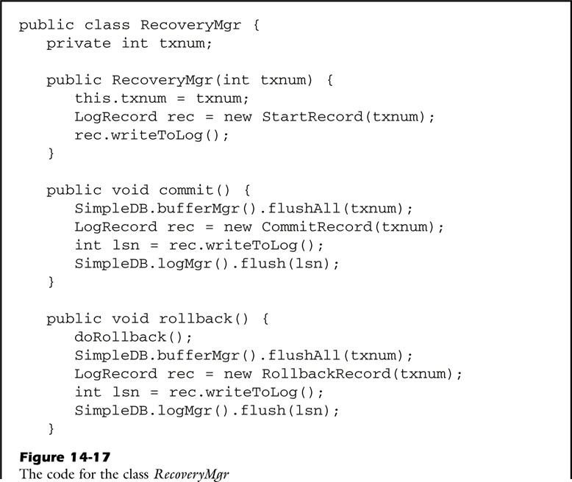
Rollback and Recover
The following code for each method implements the undo-only algorithm.
Notes:
The following code implements the undo-only algorithm.
This code has methods for recovery management.
Commit operation first must flush buffer before log is flushed to the disk.
Rollback operation do rollback for uncommit transaction.

Slide 34
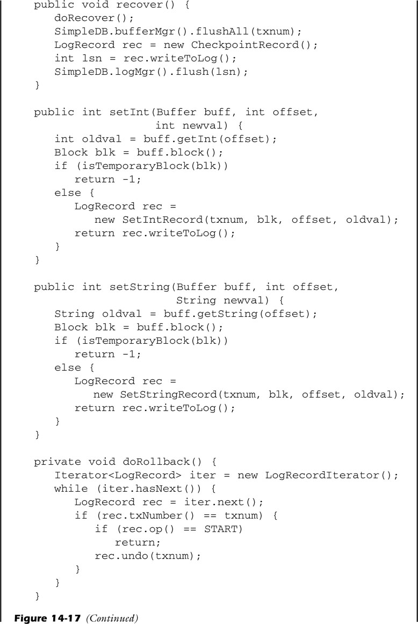
Rollback and Recover (cont’)
Notes:
Recover method does recover for committed transaction.
setInt and setString write update log record for update transaction.
The dorollback method reads log records until it hits the start record for the given transaction.

Slide 35
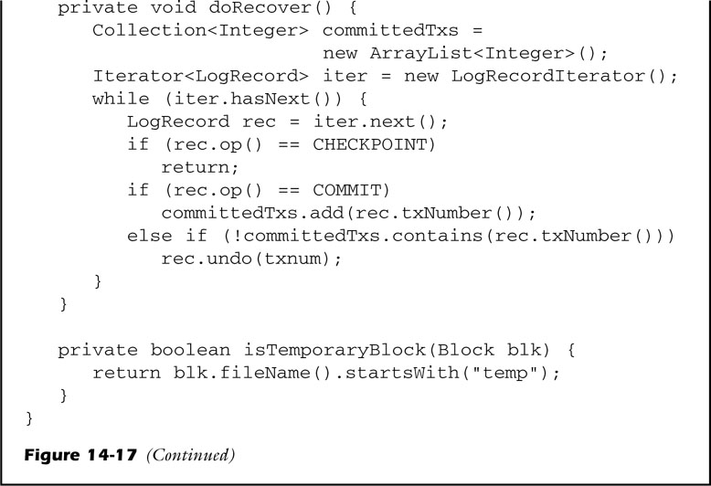
Rollback and Recover (cont’)
Notes:
The dorecover method reads the log until it hits a quiescent checkpoint record or reaches the end of the log.

Slide 36
Contents
Transactions
Using Transactions in SimpleDB
Recovery Management
Concurrency Management
Serializable Schedules, The Lock Table, The Lock Protocol, Dead Lock
File-Level Conflicts and Phantoms, Multiversion Locking
Transaction Isolation Levels, Data Item Granularity, The SimpleDB Concurrency Manager
Implementing SimpleDB Transactions
Notes:
Now, I explain concurrency management.

Slide 37
Serializable Schedules
History: the sequence of database actions made by that transaction.
Database action : The reading or writing of a disk block
The actual sequence of operations will be an unpredictable interleaving of the histories of its transactions.
Call that interleaving a schedule
int gy = tx.getInt(new Block(“student.tbl”, 0, 38);
String sname = tx.getString(new Block(“student.tbl”, 0), 46)
tx.setInt(new Block(“student.tbl”, 0), 38, gy+1);
Tx:
R(student.tbl, 0);
R(student.tbl, 0);
W(student.tbl, 0);
The history of an above transaction
Notes:
This indicates the two parts of transaction tx. In here, getInt, getstring, and setint method are access a database file.
So, This methods could be written to the following.
This expression is named the history. Because getint and getstring methods are the read method, they are written to R,
And because setint method is the write method, this is written to W.
So, History of transaction describe the sequence of database actions made by that transaction.
Database action means the reading or writing of a disk block.
But, the actual sequence of operations will be an unpredictable interleaving of the histories of its transactions.
This chapter calls that interleaving a schedule

Slide 38
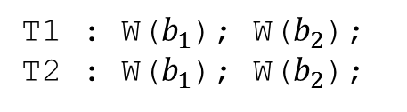
Serializable Schedules (cont’)
Schedule
The interleaving of the histories of the transactions
Serial schedule
A schedule in which the histories are not interleaving
Example: Serial schedule
Different serial schedule of the same transaction can give different results.
The result of either serial schedule is correct
T1 executes before T2, or T2 executes before T1
There can be several correct results.
T1 : W($b_{1}$); W($b_{2}$);
T2 : W($b_{1}$); W($b_{2}$);
Assume that T1 might write an “X”, whereas T2 might write a “Y”
Notes:
Schedule means the interleaving of the histories of the transactions.
The purpose of concurrency control is to ensure that only correct schedule get executed.
Simply schedule is not interleaved schedule. This is called to serial schedule.
Serial schedule means a schedule in which the histories are not interleaving.
For example. Suppose that we have two transactions the following.
Assume that T1 might write an X, T2 might write a Y.
Different serial schedule of the same transaction can give different results.
If T1 execute before T2, the blocks will contain the values written by T2, but if T2 executes before T1, the blocks will contain the values written by T1.
The key point in here is the result of either serial schedule is correct.

Slide 39


Serializable Schedules (cont’)
Serializable schedule
A schedule that produces the same result as some serial schedule
Example : Serializable schedule
Consider the following non-serial schedule of the prior example transactions:
A schedule is correct if and only if it is serializable.
Each transaction must have the ACID property of isolation.
W1($b_{1}$); W2($b_{1}$); W1($b_{2}$); W2($b_{2}$);
Serializable schedule
W1($b_{1}$); W2($b_{1}$); W2($b_{2}$); W1($b_{2}$);
Non-serializable schedule
Notes:
Serializable schedule means a schedule that produces the same result as some serial schedule.
For example, consider the following non-serial schedule of the prior example transactions.
The Result of the schedule is the same, if T1 executes before T2, or not.
But, the result of this schedule cannot be produced by any serial schedule.
Although T1 executes before T2, block2 is written by T1.
So, This result is serializable, this result is non-serializable.
A schedule is correct if and only if it is serializable.
And, each transaction must have isolation property.

Slide 40
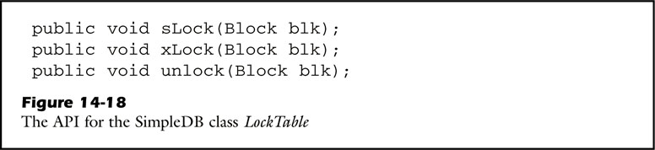
The Lock Table
Locking is a common technique for ensuring that all schedules are serializable.
This postpones the execution of a transaction.
Two kinds of lock:
A shared lock (slock)
Other transactions are only allowed to have shared locks on it.
A exclusive lock (xlock)
No other transaction is allowed to have any kind of lock on it.
Lock table
the portion of server that is responsible for granting locks to transactions
Notes:
The database system is responsible for ensuring that all schedules are serializable.
A common technique is to use locking to postpone the execution of a transaction.
Each block has two kinds of lock.
If a transaction has a shared lock, then other transactions are only allowed to have shared locks on it.
But if a transaction has an exclusive lock, then no other transaction is allowed to have any kind of lock.
This figure is the API for locktable class.
The lock table is the portion of the server that is responsible for granting locks to transactions.
As you see, locktable class has slock, xlock, unlock method.

Slide 41
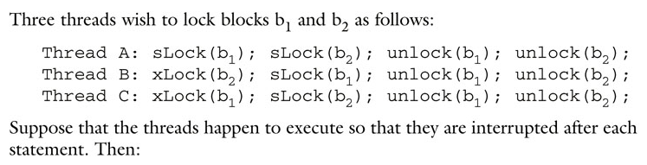
The Lock Table (cont’)
slock(Thread A)
xlock(Thread C)
Block 1
Block 2
slock(Thread A)
xlock(Thread B)
slock(Thread B)
Notes:
For example, Three threads wish to lock blocks b1 and b2 as follows.
First of all Thread A obtains an slock on b1. and next,
Thread B obtains an xlock on b2. However
Thread C cannot get an xlock on b1, because block 1 already has lock. Thus thread C waits.
Thread A also cannot get an slock on b1, because block 2 already has an xlock. Thus thread A also waits.
Thread B can continue. It obtains an slock on b1. slock can be allowed on block, if block of transaction has only slock.
Like this, two locks waits, because previous locks of thread A and C is not obtained on block.
Thread B unlock b1.

Slide 42
The Lock Table (cont’)
slock(Thread A)
xlock(Thread C)
Block 1
Block 2
slock(Thread A)
xlock(Thread B)
Notes:
Next, thread B unlock b1.

Slide 43
The Lock Table (cont’)
slock(Thread A)
xlock(Thread C)
Block 1
Block 2
slock(Thread A)
Notes:
Thread B can continue. So, it unlocks b2.

Slide 44
The Lock Table (cont’)
xlock(Thread C)
Block 1
Block 2
slock(Thread A)
slock(Thread A)
Notes:
Thread A can continue, and obtains it slock on b2.
Thread A unlocks b1

Slide 45
The Lock Table (cont’)
Block 1
Block 2
xlock(Thread C)
slock(Thread A)
slock(Thread C)
Notes:
Thread C finally is able to obtain its xlock on b1.
Threads A an C continue in any order until they complete.
Thread C obtains it slock on b2.

Slide 46
The Lock Table (cont’)
Block 1
Block 2
xlock(Thread C)
slock(Thread A)
slock(Thread C)
Notes:
Thread A unlocks on b2.

Slide 47
The Lock Table (cont’)
Block 1
Block 2
slock(Thread C)
Notes:
Consecutively, Thread C can continue, and unlocks on b1, b2.

Slide 48
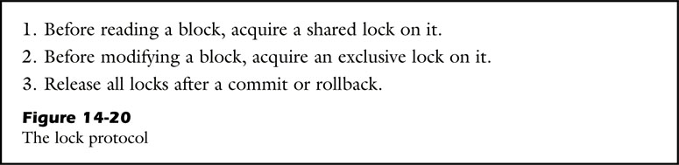
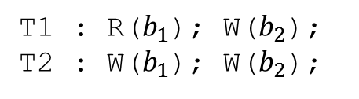
The Lock Protocol
① : read-write conflict / ② : write-write conflict
Two operations conflict if the order in which they are executed can produce a different result.
Note that two read operations cannot ever conflict, nor can operations involving different blocks.
Locking can be used to avoid write-write and read-write conflicts.
T1 : R($b_{1}$); W($b_{2}$);
T2 : W($b_{1}$); W($b_{2}$);
①
②
Notes:
Consider two transactions having the following histories.
Two operations conflict if the order in which they are executed can produce a different result.
If read method and write method make a different result, it calls that their operations conflict.
If two write method of two transactions make a different result, it call that their operations conflict.
However, two read operations cannot ever conflict, nor can operations involving different blocks.
In other words, only one write operation makes a conflict.
Locking can be used to avoid two conflicts.
This figure indicates the lock protocol.
Protocol 읽기

Slide 49
The Lock Protocol (cont’)
If all transactions obey the lock protocol, then:
The resulting schedule will always be serializable.
The equivalent serial schedule is determined by the order of the transactions commit.
The lock protocol forces transactions to hold their locks until they complete.
Two problems can occur when a transaction releases its locks early:
It may no longer be serializable.
Other transactions can read its uncommitted changes.
Notes:
If all transactions obey the lock protocol, the result of schedule will always be serializable, and the equivalent serial schedule is determined by transaction commit order.
The lock protocol forces transactions to hold their locks until they complete.
It can drastically limit the concurrency in the system.
If a transaction releases its locks early, it may no longer be serializable, and other transactions can read its uncommitted changes.

Slide 50
The Lock Protocol (cont’)
Serializability Problems
Suppose that T1 is interrupted during the time interval between the unlock of x and the slock y.
The resulting schedule is non-serializable.
Two-phase locking
Allows a transaction to begin releasing locks as soon as it has acquired all of them
T1: … … … R(x); UL(x); SL(y); R(y); … … …
Notes:
First problem is serializability problem.
For example of this problem, suppose that T1 is interrupted during the time interval between the unlock of x and the slock y.
If other transaction T2 write to between x and y, T1 will read the version of block y written by T2.
Thus, the resulting schedule is non-serializable.
For the solution of this problem, a transaction acquires all of its lock before unlocking any of them.
This variant of the lock protocol is called two-phase locking.

Slide 51
The Lock Protocol (cont’)
Reading Uncommitted Data
Transactions will be able to read uncommitted data.
(Suppose that T1 does a rollback.)
Then T2 will also have to rollback. = cascading rollback
Cascading rollback
Solution
: DBMS always waits until a transaction completes before releasing its exclusive locks.
… … … W1(b); UL1(b); SL2(b); R2(b); … … …
Notes:
Second problem is reading uncommitted data.
Suppose that T1 writes to block b and unlock it. Transaction 2 then locks and reads b.
If T1 does a rollback, T2 will also have to rollback. And if T2 rolls back, this could cause still other transactions to roll back.
This phenomenon is called cascading rollback.
For the solution of this problem, database system always wait until a transaction completes before its exclusive locks.

Slide 52
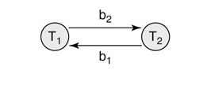
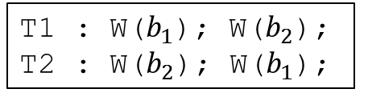
Deadlock
A deadlock occurs when there is a cycle of transactions.
The lock protocol does not guarantee that all transactions will commit.
The concurrency manager can detect a deadlock: “wait-for” graph
Every time a lock is requested or released, the graph is update.
A deadlock exists if the waits-for graph has a cycle.
T1 : W($b_{1}$); W($b_{2}$);
T2 : W($b_{2}$); W($b_{1}$);
Notes:
Although the lock protocol guarantees will be serializable, it does not guarantee that all transactions will commit.
This phenomenon is called deadlock.
The concurrency manager detects a deadlock using “wait-for graph”.
For example, Suppose that we have two transaction. If we makes wait-for graph using this schedule of two transactions, graph indicates the following.

Slide 53
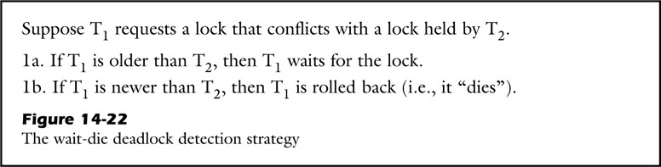
Deadlock (cont’)
Deadlock detection strategies
Wait-die
Time-limit
The wait-die deadlock detection strategy
Ensures that all deadlocks are detected
Also treats every potential deadlock as a cause for rollback
Notes:
Deadlock detection strategies consists of wait-die, and time-limit.
First, the wait-die strategy ensures that all deadlocks are detected.
The figure indicates the wait-die strategy. It treats every potential deadlock as a cause for rollback.
For example, suppose transaction T1 is older than T2.
Then T2 requests a lock currently held by T1.
The strategy will preemptively roll back T2.

Slide 54
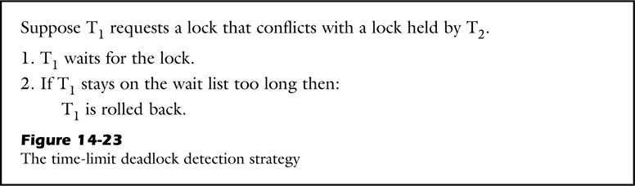
Deadlock (cont’)
The time-limit deadlock detection strategy
Use a time limit to detect a possible deadlock
If a transaction has been waiting for some preset amount of time, the transaction manager will roll it back.
Notes:
Second strategy is the time limit.
This strategy use a time limit to detect a possible deadlock.
So, as you see, if a transaction has been staying on the wait list too long, it will be roll back.

Slide 55
File-Level Conflicts and Phantoms
File-level conflicts involve the methods size and append.
Size and append method read and write the end-of-file marker.
Phantom problem
The consequences of file-level conflict
The concurrency manager can avoid the phantom problem by allowing transactions to lock the end-of-file marker.
append method: xlock
size method: slock
Notes:
We have considered the conflicts that arise from the reading and writing of blocks.
Another kind of conflict involves the methods size and append.
This methods read and write the end-of-file marker.
One of the consequences of this conflict is called phantom problem.
The concurrency manager can avoid the phantom problem by allowing transactions to lock the end-of-file marker.
Append method needs to xlock, and size method needs to slock.

Slide 56
Multiversion Locking
Read-only transactions
share locks
never have to wait for each other
The transactions in most database applications are predominantly read-only.
A lot of waiting is going to occur when read-only and update transactions conflict.
Researchers have developed strategies that can reduce this waiting.
: multiversion locking
Notes:
A shared lock for read transaction never have to wait for each other.
If an update transaction want to write, it needs to wait until all of the read-only transactions have completed.
So, researchers have developed strategies that can reduce this waiting, and it is called multiversion locking.

Slide 57
Multiversion Locking
The principle of multiversion Locking
Each version of a block is time-stamped with the commit time of update transaction.
Concurrency manager uses the version that was most recently committed at the time the transaction begin. (when a read-only transaction requests a value)
Advantage: read-only transaction do not need to obtain lock.
Multiversion locking only applies to read-only transactions.
Notes:
In multiversion locking, each version of a block is time-stamped with the commit time of update transaction.
Next, concurrency manager uses the version that was most recently committed at the time the transaction begin.
A advantage of this strategy is that read-only transaction do not need to obtain lock.

Slide 58
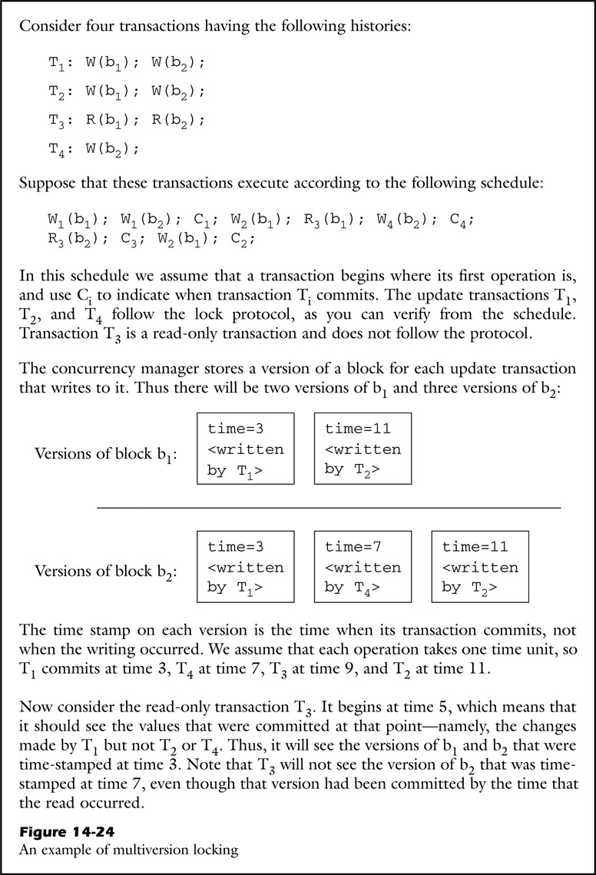
Multiversion Locking (cont’)
Example: Multiversion Locking
Schedule of transactions
Assumption:
Commit time
T1=3 / T4=7 / T3=9 / T2=11
T3 of start time (read-only transaction) : 5
Notes:
For example, consider four transactions having the following histories.
In here, T3 is read-only transaction.
Suppose that these transactions execute according to the following schedule.
The concurrency manager stores a version of a block for each update transaction.
We assume that commit time of each operation is that T1 is 3, T4 is 7, T3 is 9, T2 is 11.
But, consider the read-only transaction begin at 5.
T3 will read the versions of b1 and b2 that were time-stamped at time 3.

Slide 59
Multiversion Locking (cont’)
Implementing Multiversion Locking
The basic issue of multiversion locking is how to maintain the versions of each block.
The log can be used to reconstruct any desired version of a block.
For commit procedure of an update transaction
A timestamp is chosen for this transaction.
The recovery manager places the time stamp in the transaction’s commit log record.
The concurrency manager pins a buffer to the block, writes the timestamp, and unpins the buffer.
Drawback
The implementation is complex, and requires additional disk accesses.
It does not apply to transactions that update the database.

Slide 60
Transaction Isolation Levels
Isolation level
It also relates these levels to the way that slocks are used.
Restrictive shared locking
Guarantees the correctness
Tend to be too slow for high-performance applications
Notes:
There is another way for a transaction to reduce the amount of time it waits for locks.
If a shared locking is been restrictive, it guarantees the correctness, but tend to be too slow for high-performance applications.

Slide 61
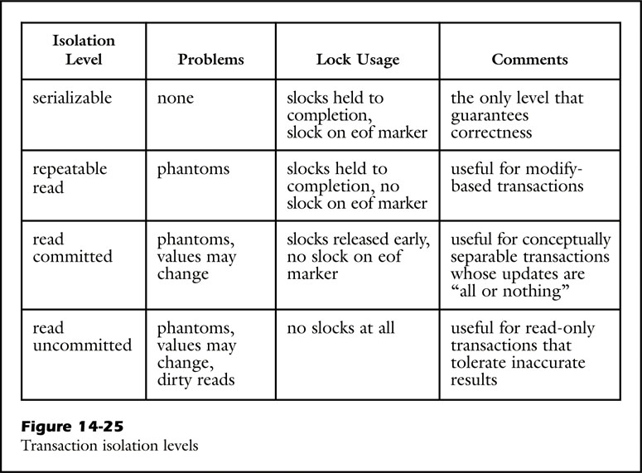
Transaction Isolation Levels (cont’)
Long
High
Wait-time
Correctness
Low
Short
Notes:
As you see, isolation level is reduced waiting time as lower, and rises correctness as higher.
First serializable isolation level is the only level that guarantees isolation property.
It hold slocks to completion, and on eof marker.
That is don’t have any problem.
Repeatable read isolation not applies slocks on eof marker.
It is useful for modify-based transactions, but it may have phantom problem.
Read committed isolation can further reduce the impact of slocks by releasing them early.
Consequently, the result of each SQL statement is consistent, but the individule results need not be consistent with each other.
This level has phantom problem, and value change.
Read uncommitted isolation is to not use slock.
A transaction that use read uncommitted isolation is fast, but also suffer from serious consistency problem.
This level is not equal to multilevel locking.
because multiversion locking uses time-stamp of update transaction, it guarantees serializable.

Slide 62
Data Item Granularity
The concurrency manager could lock other locking granularity except block.
Values
Files
Entire database. Etc
A concurrency data item is the unit of locking used by the concurrency manager.
Concurrency data item granularity has some of these tradeoffs.
Notes:
The kinds of Data item granularity of the concurrency manager is divided into value,files, entire database.
A concurrency data item granularity has some of these tradeoffs.

Slide 63
Data Item Granularity (cont’)
A smaller granularity size (= value)
Advantage: Allow for more concurrency
Disadvantage: Entail an enormous number of locks
A bigger granularity size (= file, entire database)
Advantage: Require very few locks
Disadvantage: Significantly impact concurrency
Using blocks is a reasonable compromise!
Some concurrency managers
support data items at multiple granularities
Notes:
The more size is smaller, the more allow for more concurrency. But, it entails(인테일즈) an enormous(이놀머스) number of locks.
But, if database system has a bigger granularity, this system requires very few locks, but significantly impact concurrency.
So using block is a reasonable compromise.
In addition to, concurrency managers support data item at multiple granularities.

Slide 64
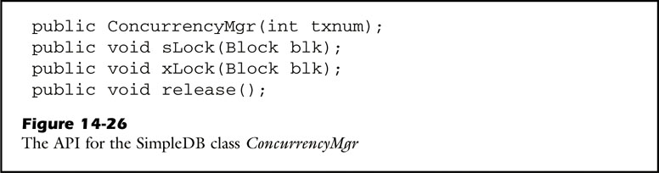
The SimpleDB Concurrency Manager
// Each transaction creates
its own concurrency manager
Notes:
Concurrency manager in simpleDB has the following method.

Slide 65
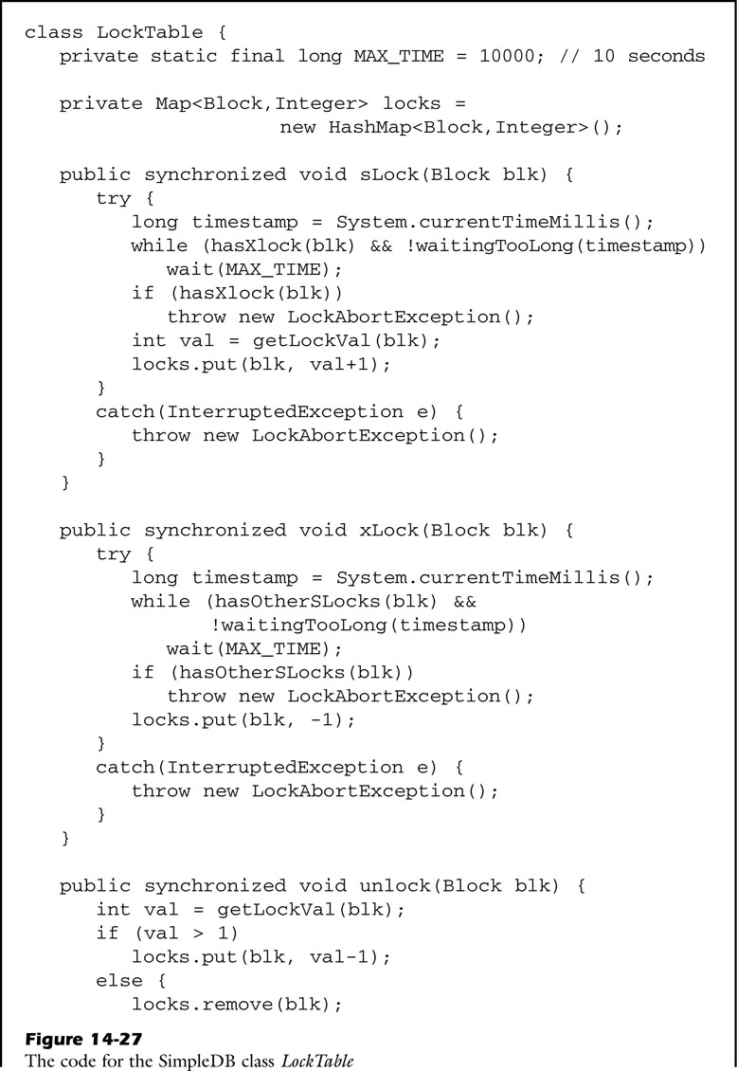
The SimpleDB Concurrency Manager (cont’)
Contains a block entry
-1 : xlock
positive : slock
True : the block has a value of -1
Notes:
Locktable class holds a map variable called locks.
This map contains an entry for each block that currently has an assigned lock.
And this integer parameter indicates the kinds of locks.
-1 denotes an exclusive lock, and a positive value denotes the number of currently shared locks.
In sharedlock method, it calls the method haxexclusivelock.
it returns true if the lock integer is a value of -1.

Slide 66
The SimpleDB Concurrency Manager (cont’)
True: the block has a value greater than 1
Notes:
On the other hands, exclusivelock method calls the hasother shared-lock method.
It returns true if the block has a value greater than 1.
Unlock method checks the value having currently block.
If a value is positive number, it is reduced to value minus 1.
But, if it is not, currently block is removed.

Slide 67
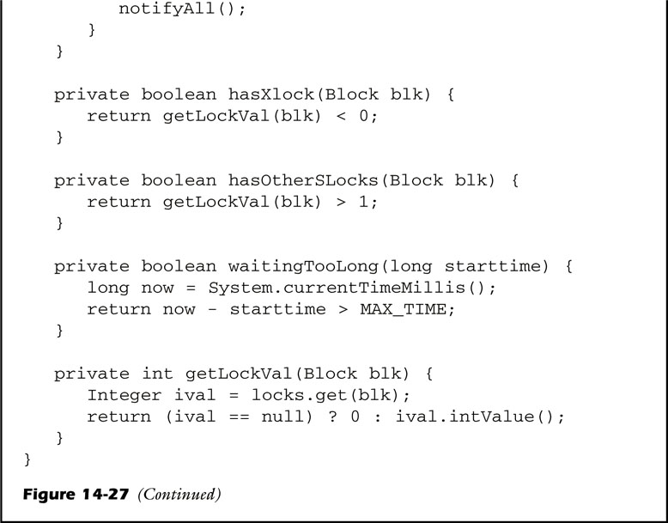
The SimpleDB Concurrency Manager (cont’)
Moves all waiting threads
to the ready list for scheduling
Notes:
Unlock method calls the notifyall method.
it moves all waiting threads to the ready list for scheduling.

Slide 68
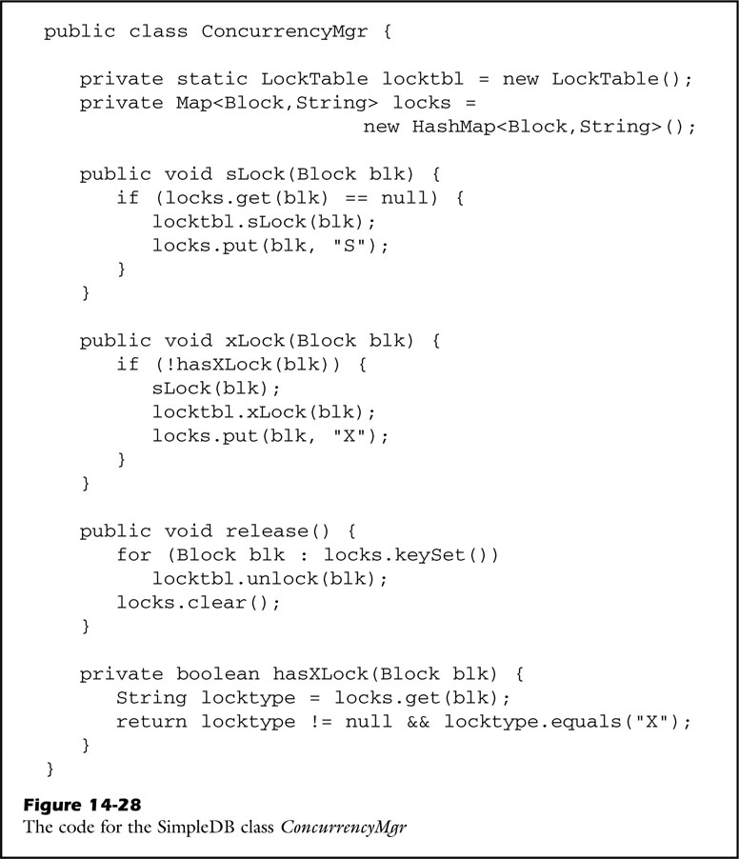
The SimpleDB Concurrency Manager (cont’)
Concurrency Manager
X : xlock
S : slock
Notes:
Concurrency manager needs to use the same lock table.
The variable locks of map object associated with the entry is either “s” or “X”.
X denotes exclusive lock , and S denotes shared lock.
Concurrency manager has four method.
Sharedlock, exclusivelock, release, hasexclusivelock.

Slide 69
The SimpleDB Concurrency Manager (cont’)
Concurrency Manager

Slide 70
Contents
Transactions
Using Transactions in SimpleDB
Recovery Management
Concurrency Management
Implementing SimpleDB Transactions
The Class Transaction
The Class BufferList
Notes:
Finally, I explain implementing simpleDB transactions.

Slide 71
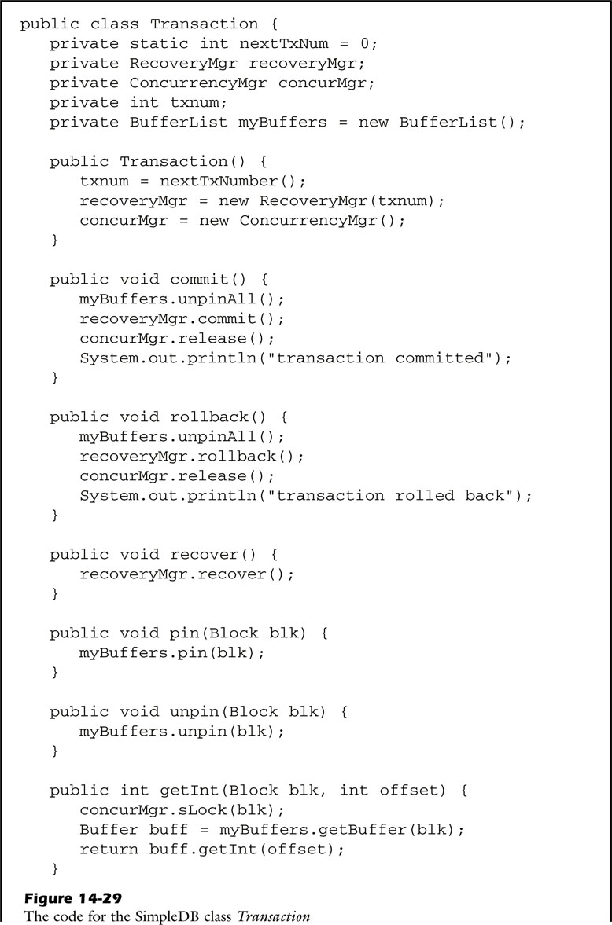
Implementing SimpleDB Transactions
Transaction
// unpin any remaining buffers
// call the recovery manage to commit the transaction
// call the concurrency manager to release its locks
Notes:
This is transaction class.
This class creates its own recovery manager and concurrency manager.
Transaction has commit and rollback method.
The commit and rollback methods perform this activities.
First they unpin any remaining buffers.
Next, they call the recovery manage to commit the transaction.
Finally, they call the concurrency manager to release its locks.

Slide 72
Implementing SimpleDB Transactions (cont’)
Transaction
// require an slock
Notes:
For read transaction, it has getint and getstring method.
So two method require an slock.

Slide 73
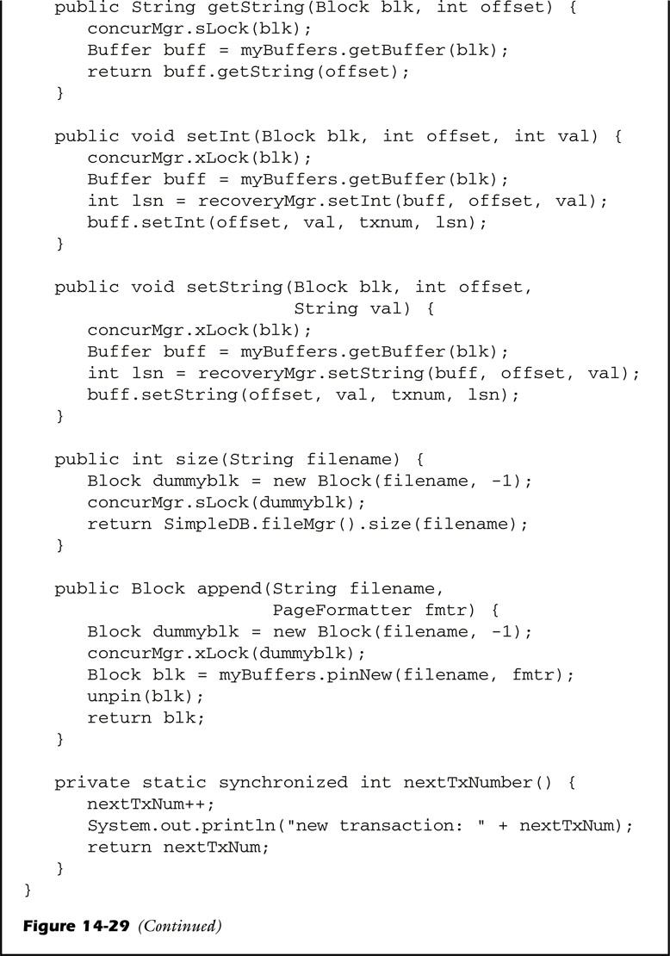
Implementing SimpleDB Transactions (cont’)
Transaction
// require an xlock
Notes:
On the other hands, setint and setstring method use for write transaction.
So, this methods require an xlock.

Slide 74
Implementing SimpleDB Transactions (cont’)
Transaction
// require an slock
Treat the EOF
as a “dummy” block
// require an xlock
Notes:
The size and append method treat the end-of-file marker as a “dummy” block with block number -1.
The size method obtains an slock, append method obtains an xlock.

Slide 75
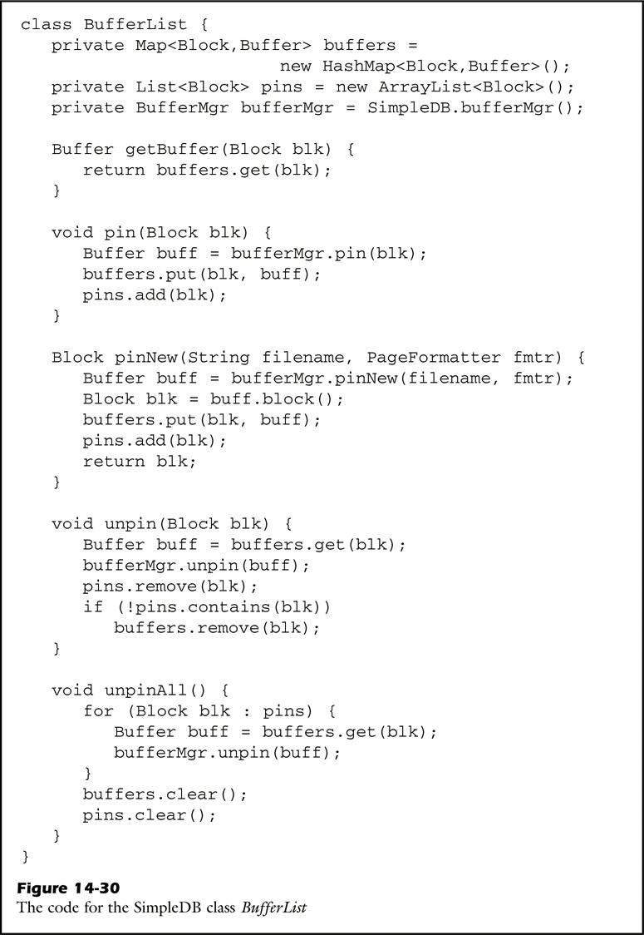
Implementing SimpleDB Transactions (cont’)
BufferList
// contains a block object
Notes:
The bufferlist class manages the list of currently pinned buffers for a transaction.
The code uses a map to determine buffers, and a list to determine pin count and contains a block object as many times as it is pinned.

Slide 76
Implementing SimpleDB Transactions (cont’)
BufferList
// performs when a transaction commits or rollback
Notes:
The method unpinall performs the buffer-related activity required when transaction commits or rollback.
It has the buffermanager flush all buffers modified by the transaction, and unpins any still-pinned buffers.

Slide 77
Q n A
Notes:
Thank you for listening! Do you have any question?

